Slide 1
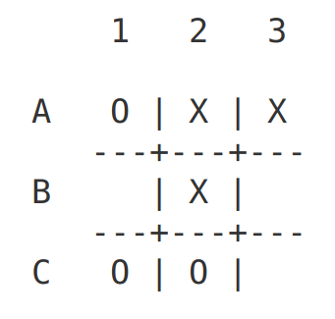
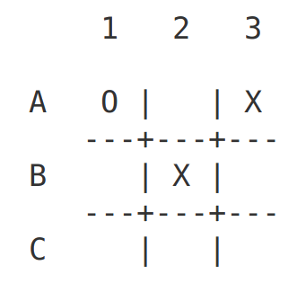
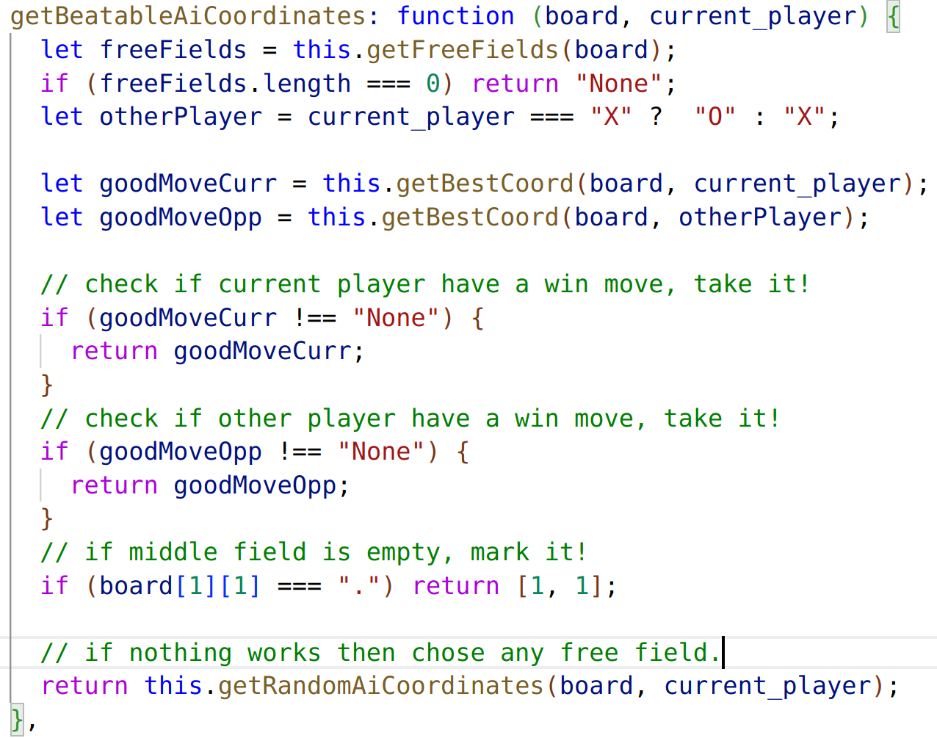
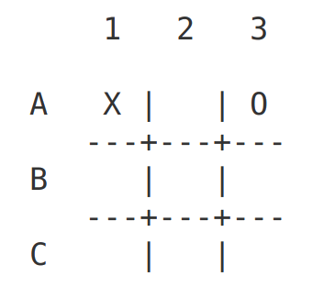

TW project: TicTacToe – Beatable Algorithm
Friday, November 18th 2022
Slide <number>
Zinaida Jusufovic
Thomas Sicay

Slide 2
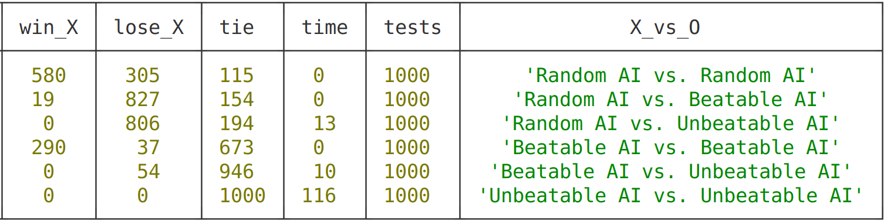
TW project: TicTacToe – Comparison
Friday, November 18th 2022
Slide <number>
Zinaida Jusufovic
Thomas Sicay

